Slide 1
Sprint 3
Niko Hildenbrand, Arnaud Harmange
EC601
Boston University

Slide 2
Goal Of This Sprint
1. To successfully implement Yolov5 DeepSort on the data set and video provided
2. To test and improve the parameters of Yolov5 DeepSort to obtain a better testing score
3. Receive visual confirmation that Yolov5 DeepSort is working on a frame by frame basis

Slide 3
What is DeepSort?
The use of deep learning to track objects in video
In the machine learning community, this is the problem of Multi-Object tracking
Utilizes object detection and tracking detection box across frames
This steps through each frame in a video and applies the deepsort algorithm to then cluster helmets across frames when it is the same helmet
We can then group each of these clusters and pick the most common label for that cluster

Slide 4
Why Yolov5 DeepSort?
In simple terms, it is much more accurate both mathematically and visually
YOLO v3
YOLO v5

Slide 5
Fine Tuning of Testing Parameters
While there a number of different sets of test parameters that we could use, we decided to use our own
Done through repeated testing of different parameters value and comparing of scores
Deepsort uses a configuration yaml file for the settings to be able to be read by our program
Default Parameters
Fine Tuned Parameters
Score before = 0.31913
Score after DeepSort = 0.53862
Score before = 0.31913
Score after DeepSort = 0.68594

Slide 6
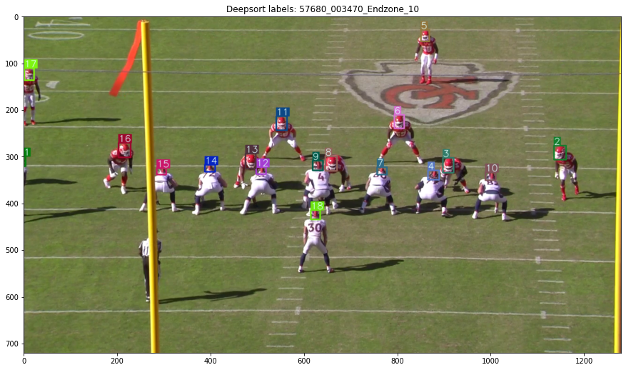
Visual Confirmation Endzone

Slide 7
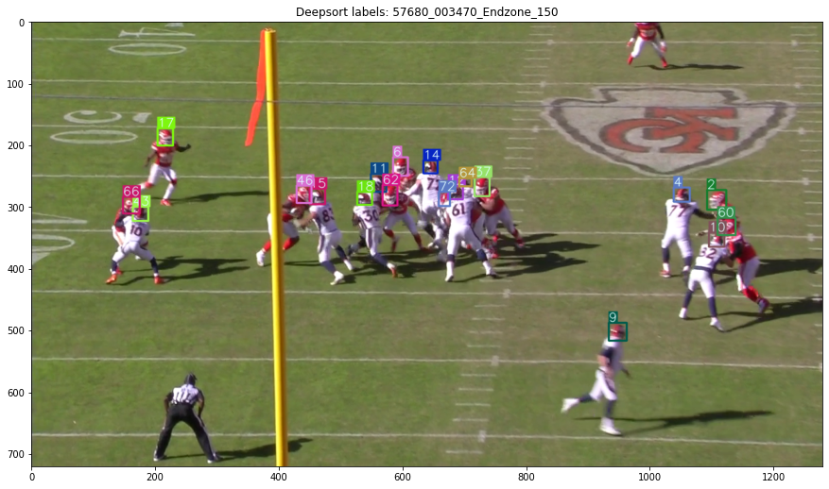
Visual Confirmation Endzone

Slide 8
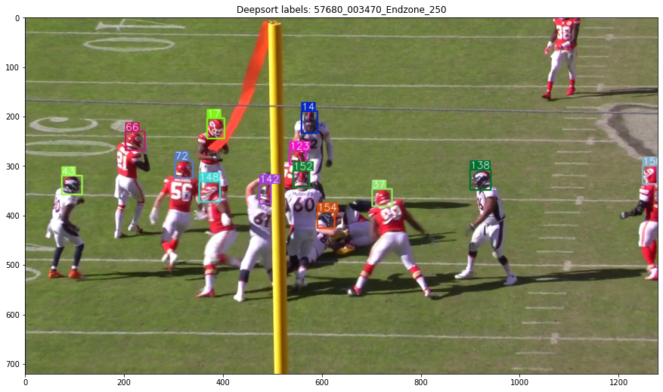
Visual Confirmation Endzone

Slide 9
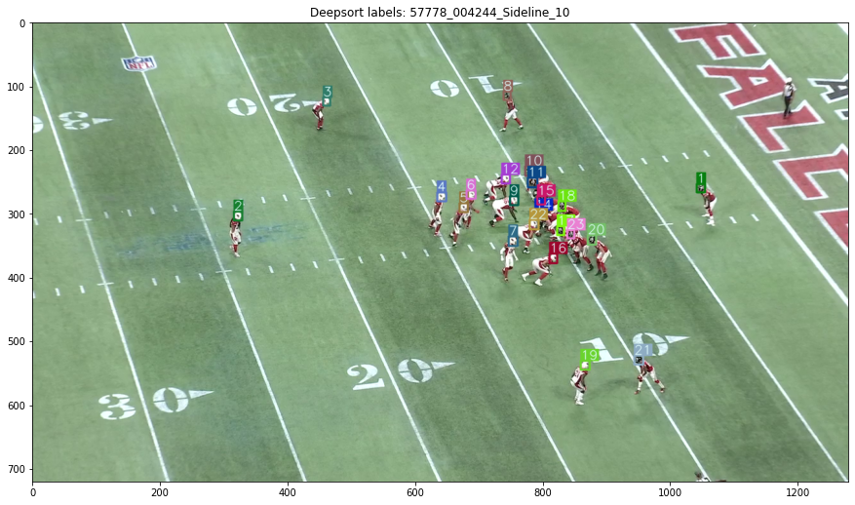
Visual Confirmation Sideline Far

Slide 10
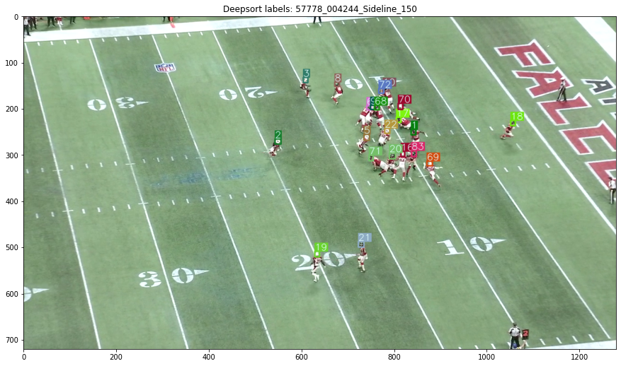
Visual Confirmation Sideline Far

Slide 11
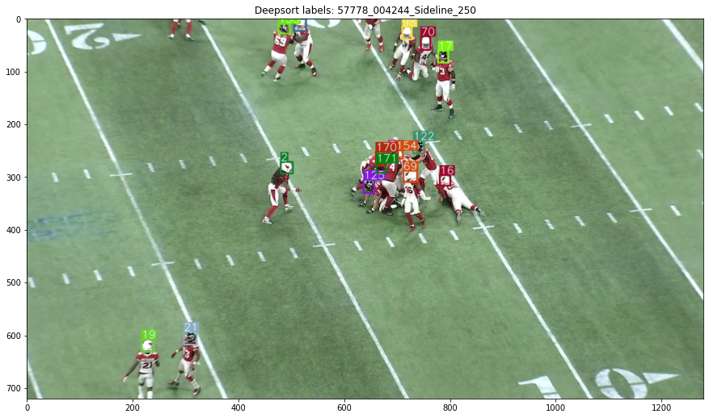
Visual Confirmation Sideline Far

Slide 12
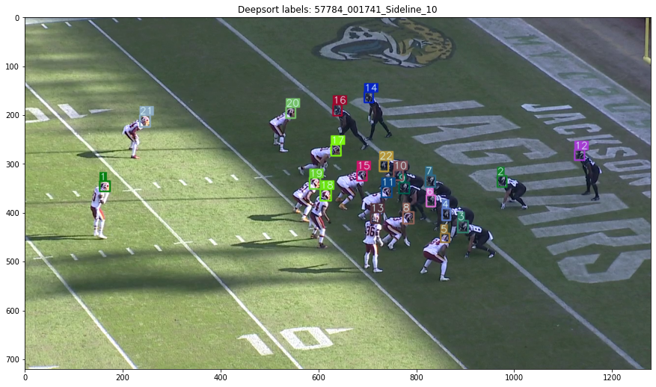
Visual Confirmation Sideline Close

Slide 13
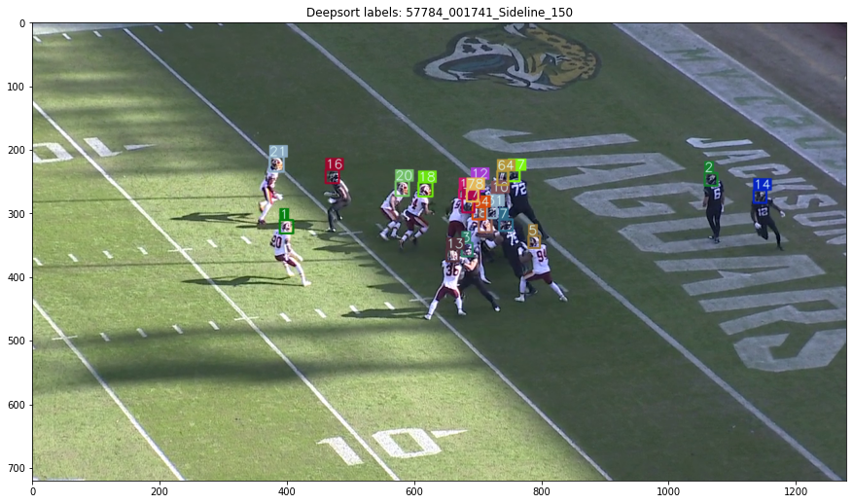
Visual Confirmation Sideline Close

Slide 14
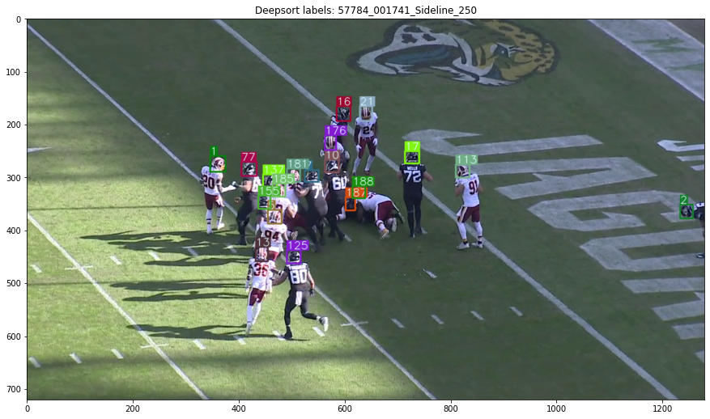
Visual Confirmation Sideline Close

Slide 15
Goals for Sprint 4
Feed our algorithm other data to see the results
Continue to fine tune parameters and compare to competition results
Begin working towards or completing the combination of individual frames to create final video

